Slide 1
Working with JPG image files
An extension for Mission 8

Slide 2
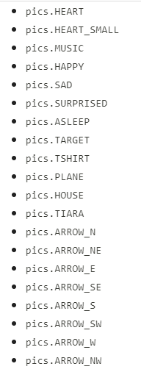
Adding JPG image files to the Codex
The CodeX comes with many images that are available through the Codex module. They are bitmapped images.

Slide 3
Adding JPG image files
But to make an interesting and original program, you will want to use your own images.
You can add images to the CodeX that are JPG files. Just follow these steps.

Slide 4
Find (or make) JPG images
Take some time to find (or make) your own JPG images.
  Be aware of copyright laws. If you look on the internet for images, look for creative commons or royalty free images.
  You should always give credit for the image in a comment in your code.
Save the JPG files somewhere easy to find, like
  Flash drive
  Google drive

Slide 5
Making the JPG image useable
Before you can upload and use the image, it needs to be the correct size and compression.
This is very important!
If you upload an image, and it doesn’t appear on CodeX, it is almost always because the size and/or compression is not correct.

Slide 6

Making the JPG image useable
You can use any editing software to prep a JPG image.
The easiest one to use is the online editor Photopea.
It is free and doesn’t require an account.
Open Photopea

Slide 7
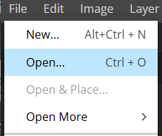
Open a JPG image
Open the JPG image in Photopea
Click on File → Open…
Find your file and open it.

Slide 8
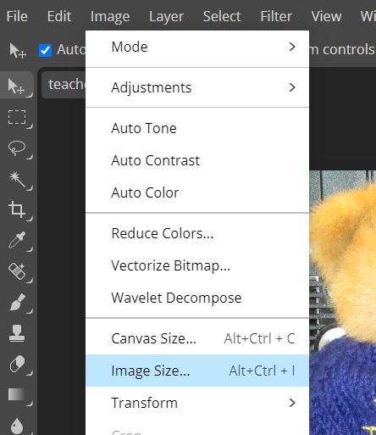
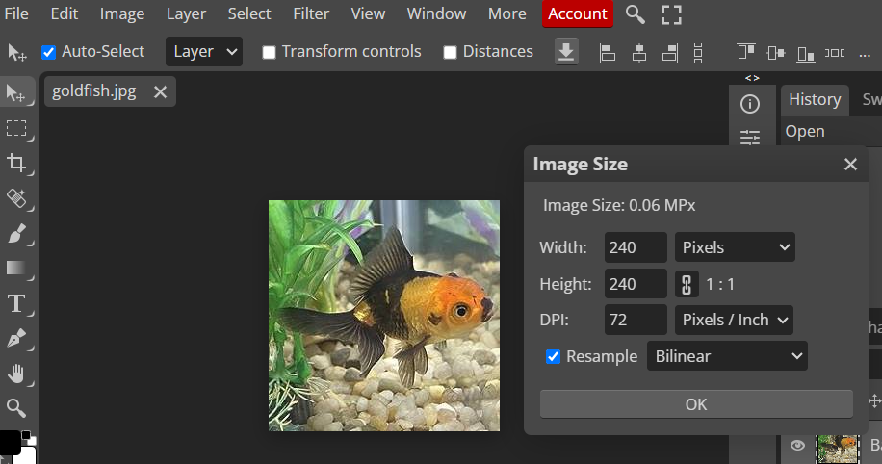
Making the JPG image useable
Change the image size to 240x240 pixels (or smaller)
Click on Image → Image Size
Change the DPI to 72

Slide 9
Making the JPG image useable
The RESAMPLE needs to be Bilinear
Change the image size to 240x240 pixels (or smaller)
Max: 240 pixels
The image does not need to be a square. The largest side should be 240.

Slide 10
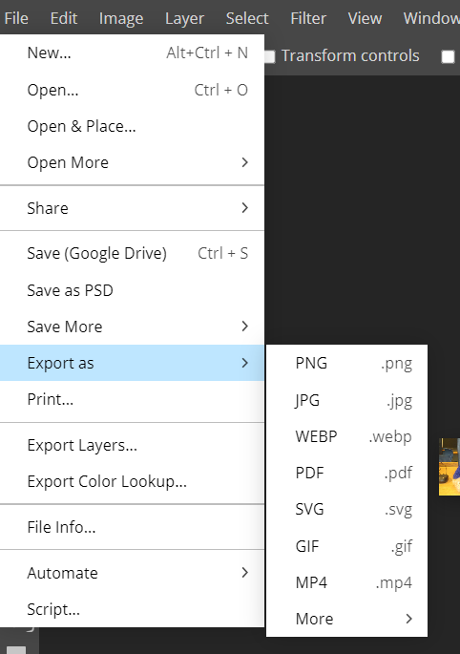
Making the JPG image useable
Export the image as a JPG
Click on File → Export as…
Choose JPG

Slide 11
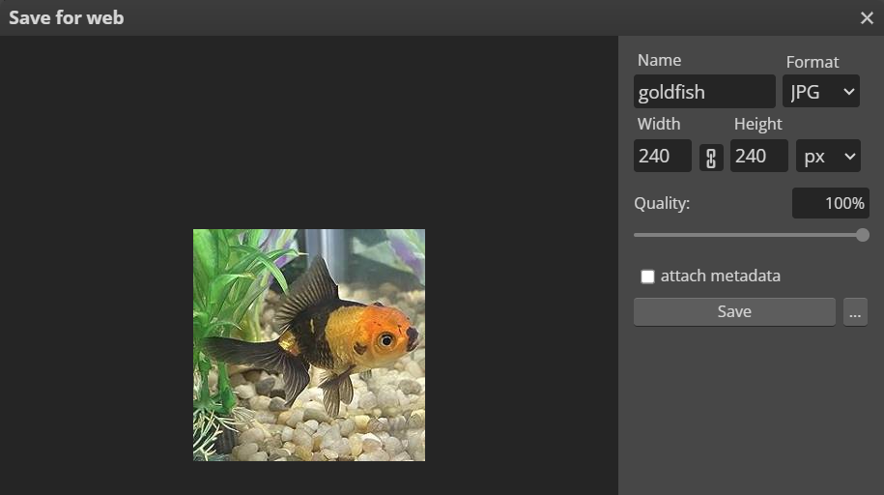
Making the JPG image useable
Export the image as a JPG
Give the image a simple name (no spaces)
Save it where
you can find it
  The best location is
  on the computer or
  flash drive so you
  can easily upload
  to the CodeX.

Slide 12
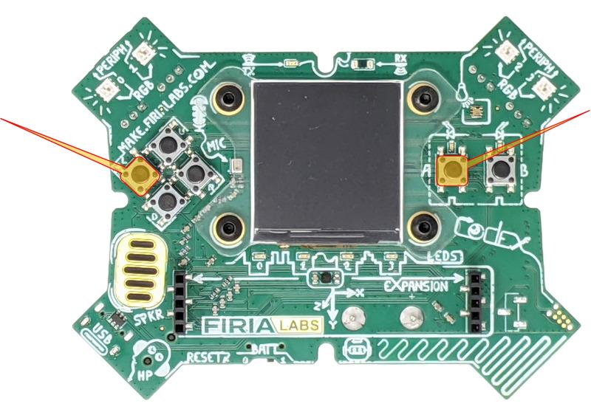
CodeX needs to be writable
Put your CodeX into USB-writable mode (youtube video demonstration)
The CodeX must be
connected to your computer
Press and hold the
L and A buttons and keep
holding them down
Reach around the back and
briefly press the RESET button
(press and release)

Slide 13
CodeX needs to be writable
Keep holding buttons A and L until you see the red LEDs light up from 3 to 0 in right-to-left order.
You will see a double-flash of ALL red LEDs to confirm the filesystem is in USB-writable mode.
Now release L and A.
You are ready to upload your CodeX files

Slide 14
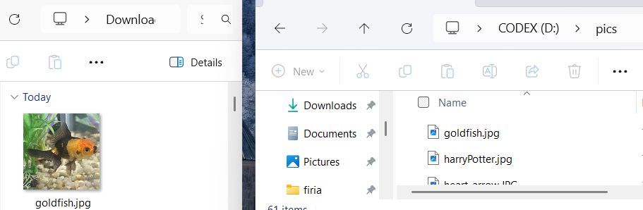
Upload JPG image files
Upload your image files to the CodeX
Create a “pics” folder in the CodeX file system.
Upload your images to the folder.

Slide 15
Read-only CodeX
In order for CodeX to run your code, it needs to be in read-only mode.
Unplug CodeX from the computer.
Plug it in again.
It is now in read-only mode.
NOTE: The files are loaded on your specific CodeX. You need to get the same CodeX every time to access your images.

Slide 16
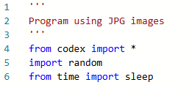
Create a list of JPG images
Open make.firialabs.com and go to the Sandbox.
Start a new file: Picture_Bot.
  This program will be similar to Answer_Bot.
Import the codex, random and time modules.

Slide 17
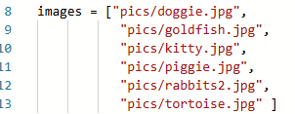
Create a list of JPG images
Create a list of your JPG images.
Each file is a string, so use quotation marks.
Include the pics folder in each filename.

Slide 18
Display the JPG image files
Use the display.draw_jpg(filename) function to display the JPG image.
image file name here, in quotes.
(use the path name if in a folder)

Slide 19
Display the JPG image files
Try each image individually. If an image doesn’t show:
Is the file a JPG (not PNG or any other image format)?
Check the filename in the code. Is it spelled correctly?
Check the function name. Is it spelled correctly?
Open the image in Photopea and redo the specifications.
Any error is almost always one of those four mistakes. If an image is still not displaying, you might want to use a different image.

Slide 20
Use the list of JPG images
Create a program similar to Answer_Bot.
Use a while True loop
When BTN-A is pressed, display a random JPG image.
Create and call a function to flash the pixels random colors.
Add a kill switch, and clear the display and pixels when the loop ends.

Slide 21
Picture_Bot program
Run the code.
Make sure it doesn’t contain any errors.
Turn in your code.

